Slide 1
Forget ODBC! Here’s a New Db2 Connector
Jonathan Zak, IBM
Software Developer
jonathan.zak@ibm.com
Sanjula Ganepola, IBM
Software Developer
sanjula.ganepola@ibm.com

Slide 2
Agenda
Mapepire Overview
Architecture and Core Tenets
Comparisons versus JDBC and ODBC
Deep dive into Node.js client SDK
Demo

Slide 3
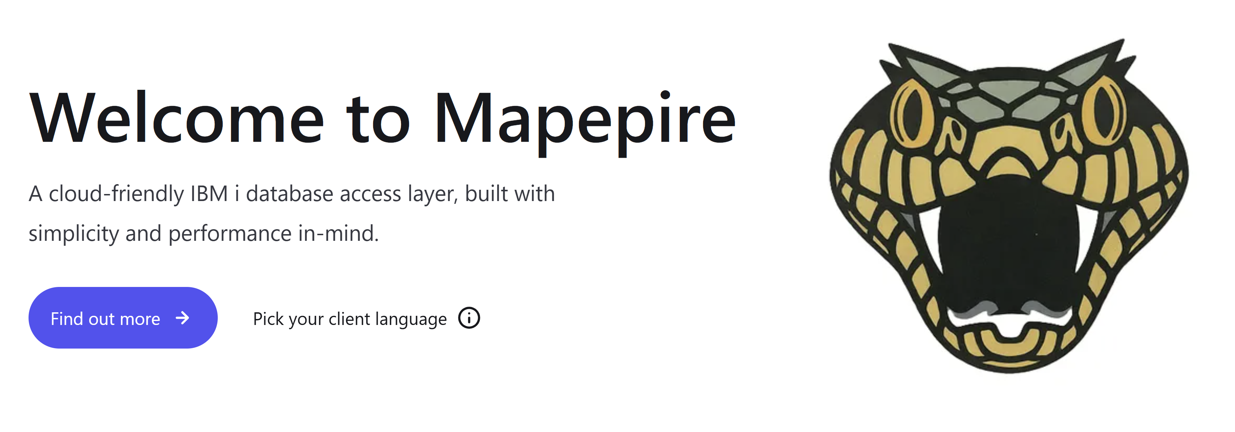





What is Mapepire?
Super easy to use way to access Db2 for i from any application

Slide 4
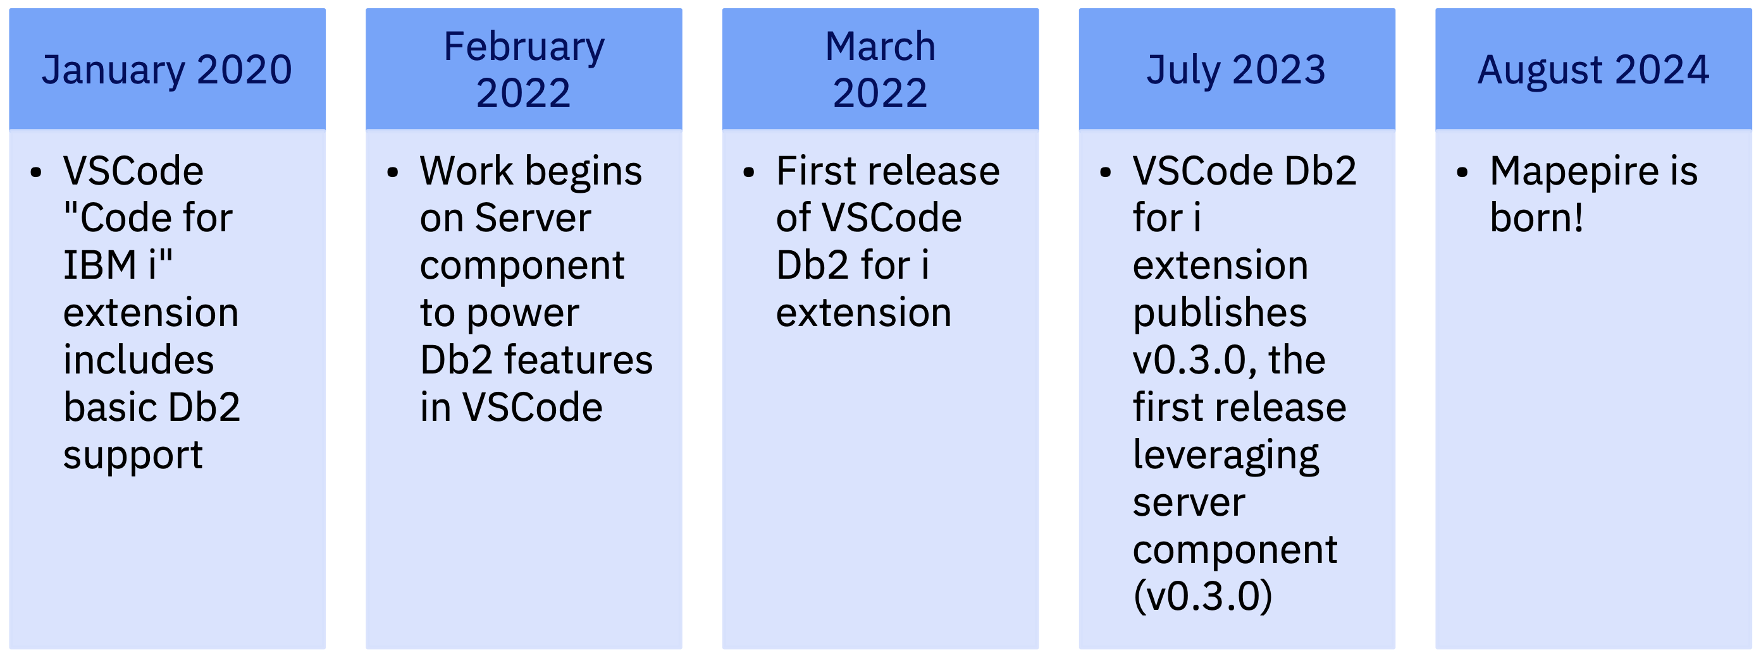



Mapepire Origin Story…

Slide 5
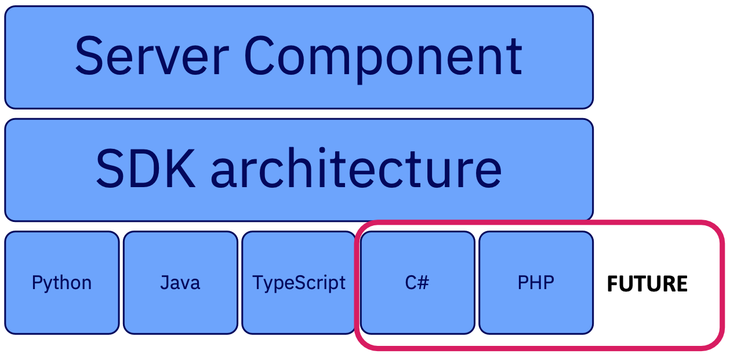
Mapepire Components

Slide 6
How does it work?
Connect to Database
Communication over secure web sockets
{
"id": "id2",
"type": "connect",
"technique": "tcp",
"application": "Java client"
}
👨🏻‍💻 Application
🤖
Server Component
IBM i
{
"id": "id2",
"job": "112480/QUSER/QZDASOINIT",
"success": true
}
Application uses Mapepire client SDK
Managed using Service Commander

Slide 7
How does it work?
Query the Database
Request
Response
{
"id": "query3",
"has_results": true,
"update_count": -1,
"metadata": {
"column_count": 1,
"job": "112480/QUSER/QZDASOINIT",
"columns": [
{
"name": "DEPTNO",
"type": "CHAR",
"display_size": 3,
"label": "DEPTNO",
"precision": 3,
"scale": 0
}
]
},
"data": [
{
"DEPTNO": "A00"
}
],
"is_done": true,
"success": true
}
{
"id": "query3",
"type": "sql",
"sql": "SELECT DEPTNO FROM SAMPLE.DEPARTMENT WHERE DEPTNO = 'A00'",
"terse": false,
"rows": 100
}

Slide 8
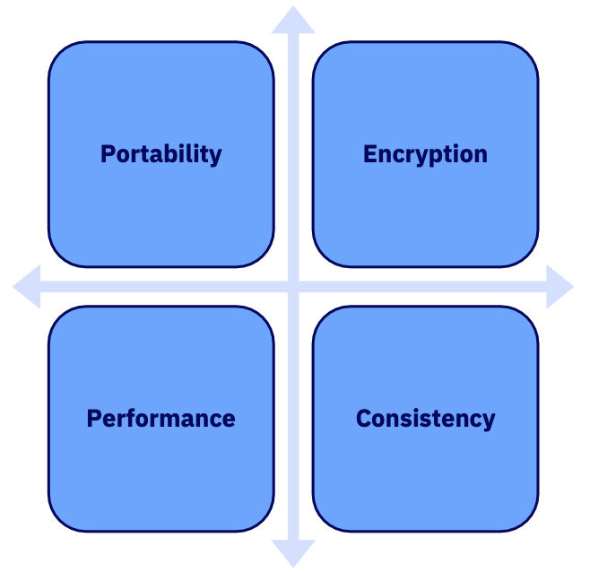
Core Tenets

Slide 9
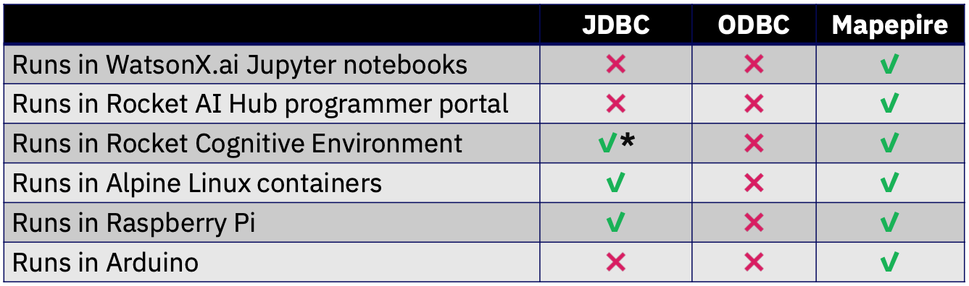
The biggest benefit of Mapepire.... Portability!!

Slide 10
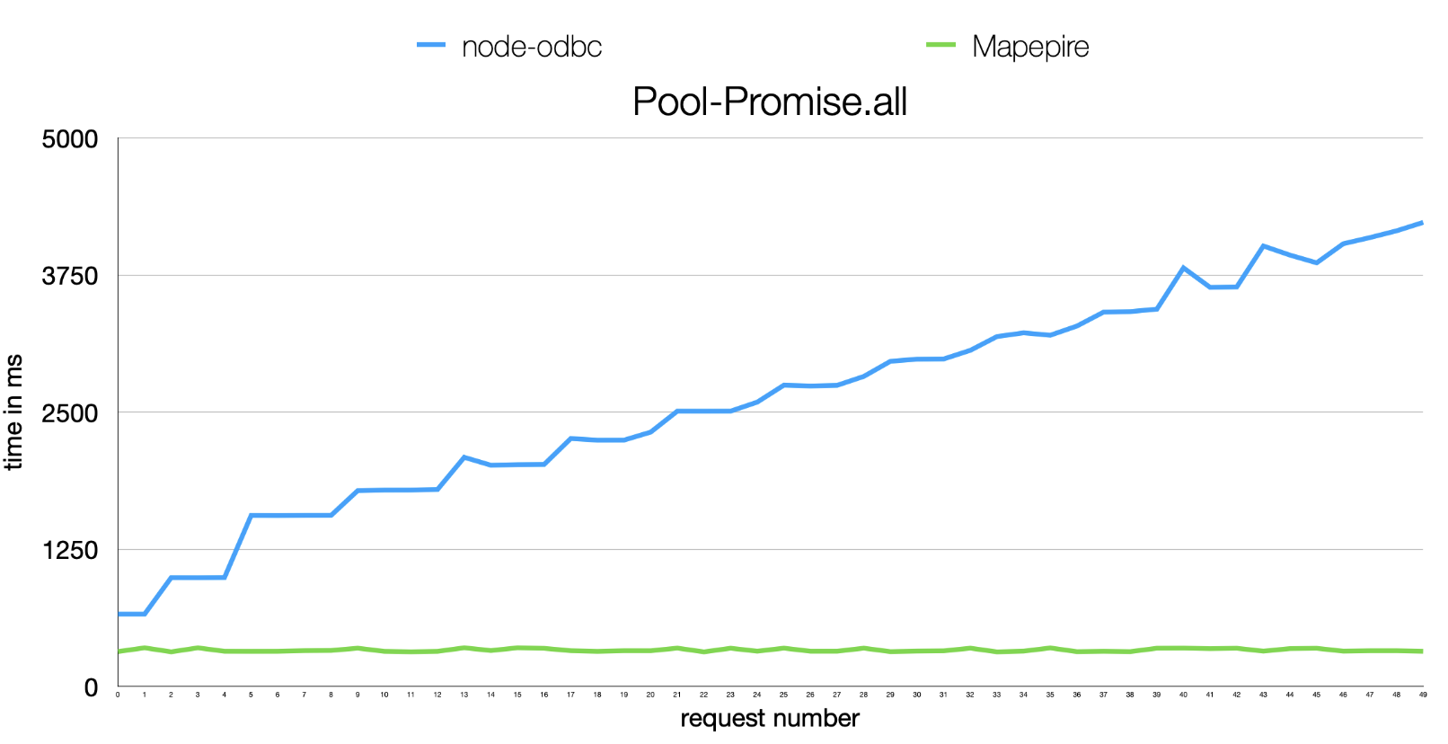
Some performance comparisons

Slide 11
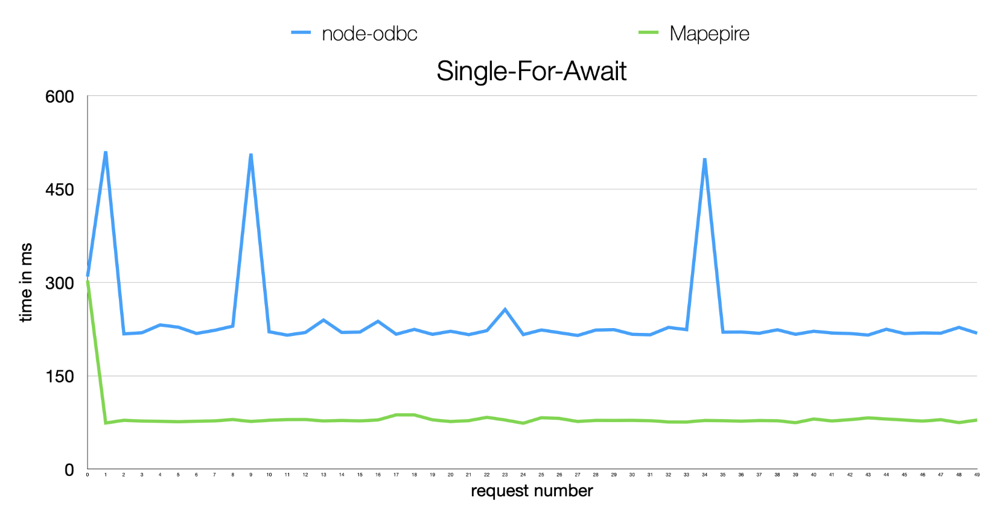
Some performance comparisons

Slide 12
How to encrypt data with JDBC/ODBC
Log into DCM
Create a local certificate authority (CA) store
Create a local CA certificate
Record the value of the auto created CA label
Create the *SYSTEM certificate store (if needed)
Create a new server certificate
Sign the server certificate with your local CA
Assign new server certificate to host server applications
Restart Host Servers
On client, download the server's certificate authority to a local trust store (or configure TLS to ignore completely)

Slide 13
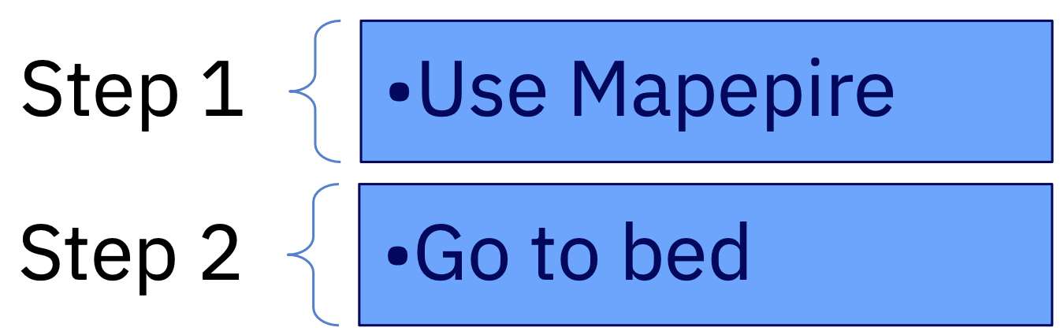
How to encrypt data with Mapepire?

Slide 14
How does Mapepire make it so easy?
Option 1: Custom certificate
Admin explicitly defined a custom certificate by configuring a certificate store:
File name: /QOpenSys/etc/mapepire/cert/server.jks
Format: JKS
Store Password: mapepire
Key Password: mapepire
Certificate Alias: mapepire
Check out documentation for full instructions: https://mapepire-ibmi.github.io/guides/sysadmin/
Option 2: Let's Encrypt
Use Let's Encrypt (ex. generated by CertBot)
Mapepire server will automatically use it as the server certificate
Certificate must exist in the following location used by CertBot: /etc/letsencrypt/live/<hostname>
Option 3: Self-signed certificate
If no certificate, the server automatically generates its own self-signed certificate

Slide 15
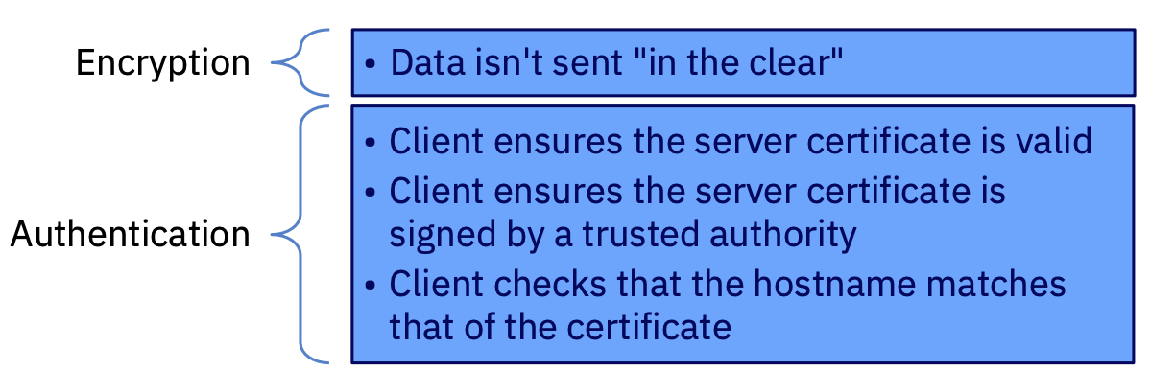
What does TLS provide?

Slide 16
Mapepire's back-end is JDBC
Mapepire is an interface in front of JTOpen and JDBC
Mapepire utilizes QZDASOINIT or, more likely, QZDASSINIT (S = "secure") jobs
All considerations for ODBC/JDBC server job scalability and security still apply
Object authority still applies
Any ODBC/JDBC exit points will still work to control traffic and access

Slide 17
How to manage the JDBC workload?
By default, all QZDASOINIT/ QZDASSINIT jobs run in QUSRWRK
Questions:
How to control out-of-control queries from query tools?
How to know which application is using up resources?
How to let critical users get the resources they need while not letting long queries take over the system?
How to manage your JDBC jobs more effectively?

Slide 18
Separate jobs by application, user, etc.
Configure your QZDASSINIT jobs to run in separate subsystems, based on your criteria
JDBCSHOP
JDBCADHOC
JDBCNODE
Then performance "waits" can be aggregated by subsystem and you can configure memory, etc. per subsystem
Easier troubleshooting as JDBC jobs from different applications will not interact
Also limit with these techniques https://www.ibm.com/support/pages/setting-limitations-resources-used-qzdasoinit-prestart-jobs
Details: https://www.seidengroup.com/2022/05/04/simplify-with-subsystems/

Slide 19
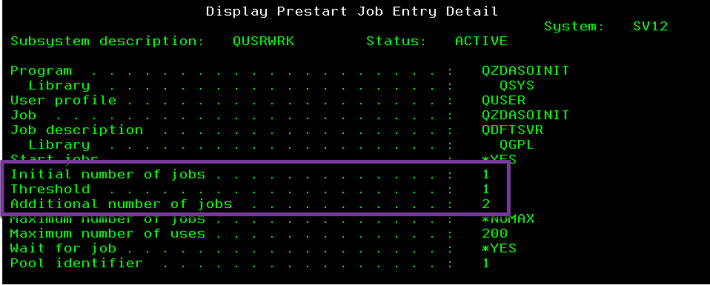
Configure JDBC Prestart jobs
Configure the right number of prestart jobs
– ODBC/JDBC prestart jobs are QZDASO(S)INIT in QUSRWRK
Check out your current configuration:
– DSPSBSD SBSD(QUSRWRK)
– Choose 10, Prestart job entries
– Type 5 next to QZDASOINIT

Slide 20
Default ODBC/JDBC prestart job settings
Low defaults
Initial jobs = 1, threshold = 1, additional jobs = 2
Change as needed:
CHGPJE SBSD(QSYS/QUSRWRK) PGM(QSYS/QZDASOINIT)
STRJOBS(*YES) INLJOBS(xx) THRESHOLD(xx)
ADLJOBS(xx)
How to determine optimal values? DSPACTPJ (coming up)

Slide 21
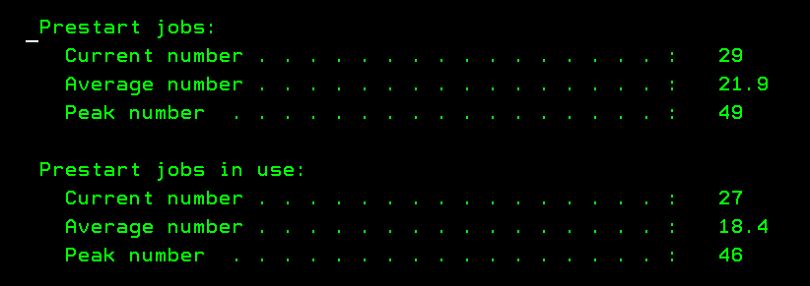
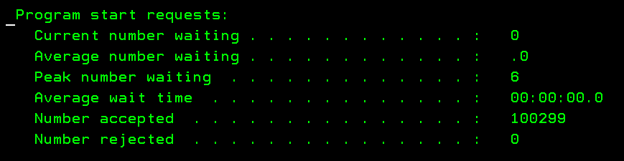
How many jobs are needed?
DSPACTPJ SBS(QUSRWRK) PGM(QZDASOINIT)
More details: https://www.ibm.com/docs/en/i/7.4?topic=jobs-tuning-prestart-job-entries

Slide 22
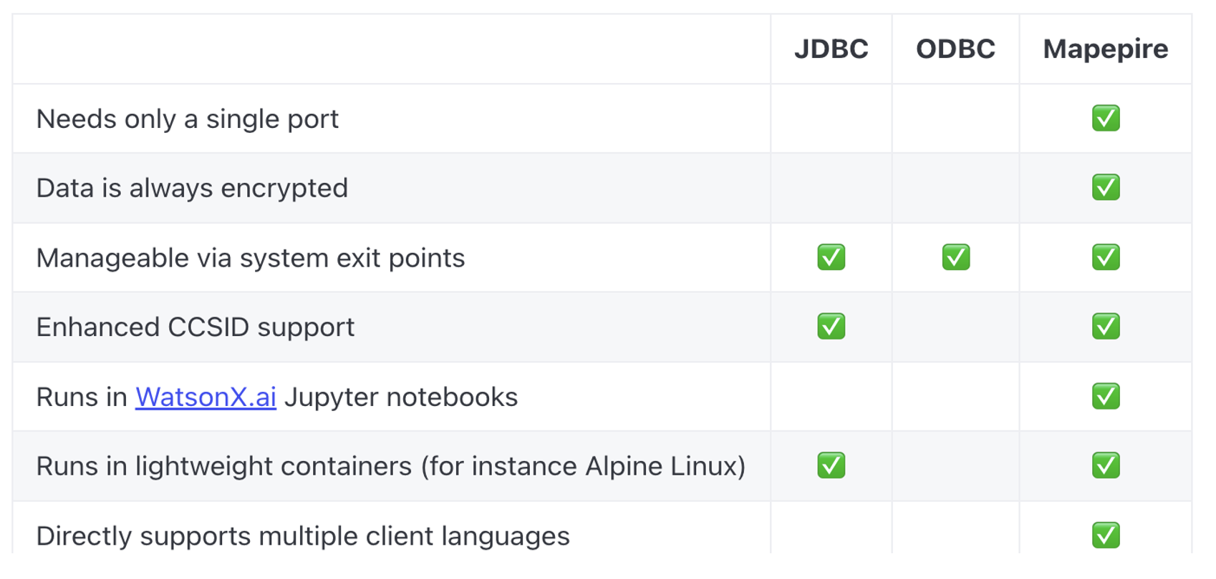
JDBC vs ODBC vs Mapepire

Slide 23
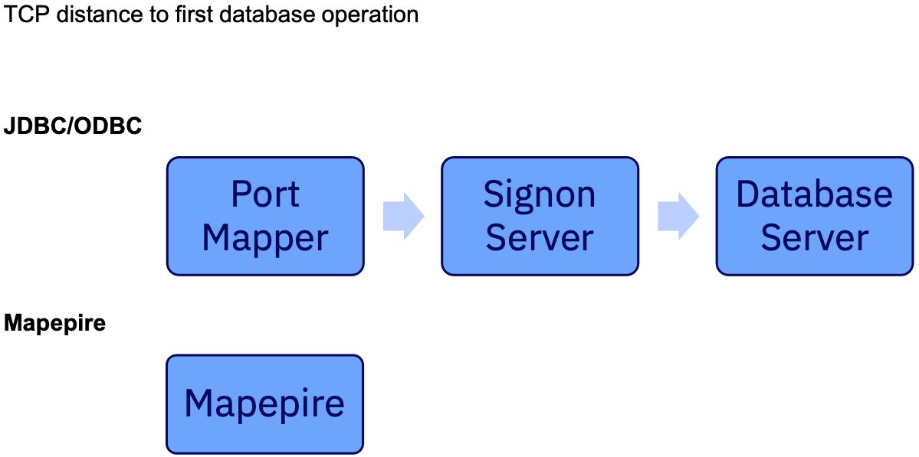
Single port? Big deal!

Slide 24
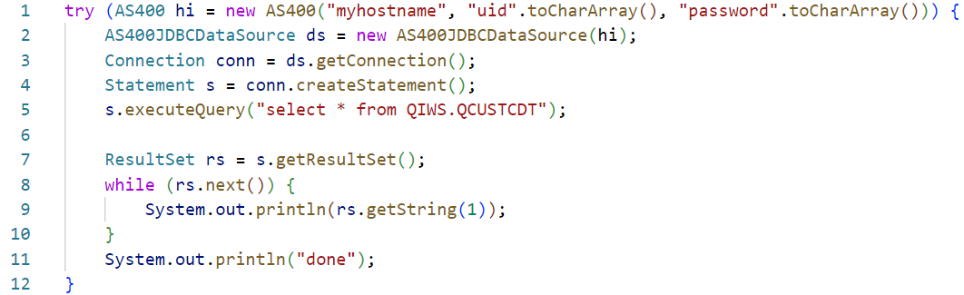
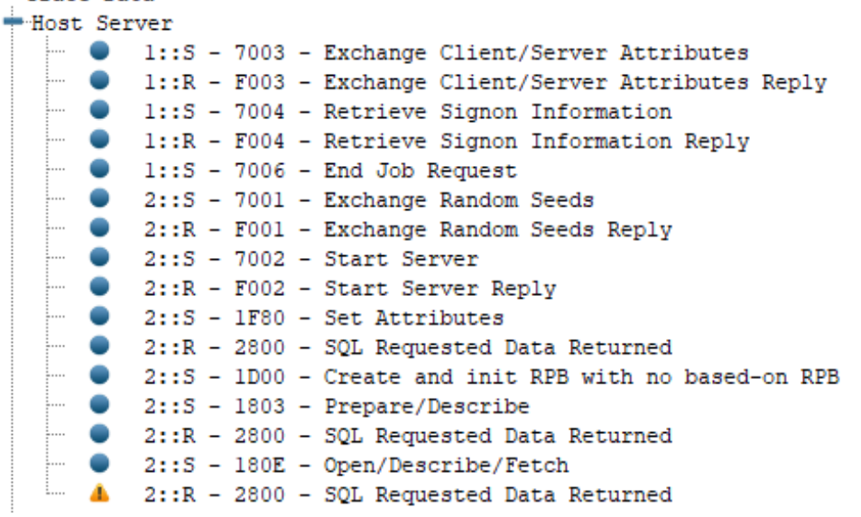
Distinct TCP flows for a JDBC program!!
Meanwhile….
✨ Mapepire only needs 2 TCP flows
Connect and allocate a job
Run a query

Slide 25
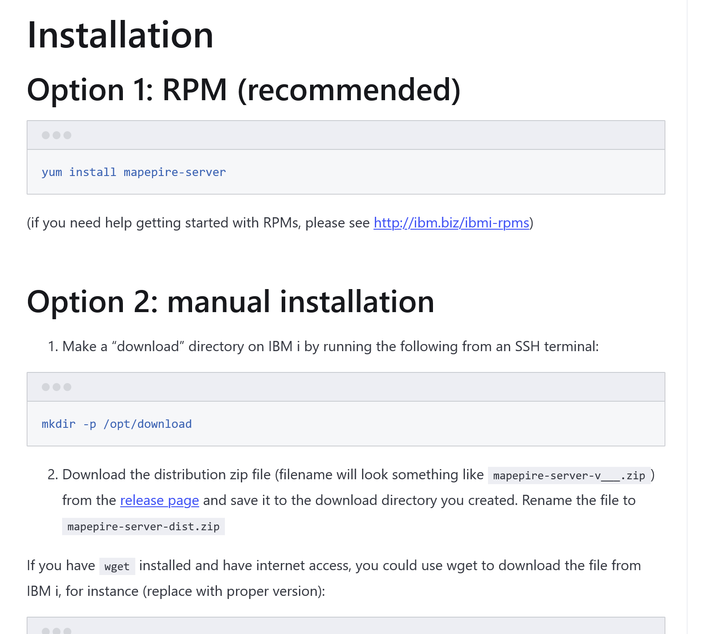
Installation made easy!

Slide 26
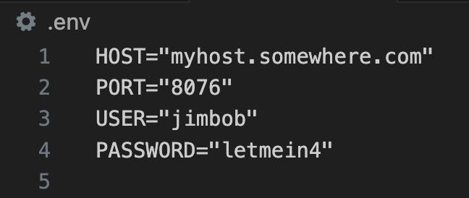
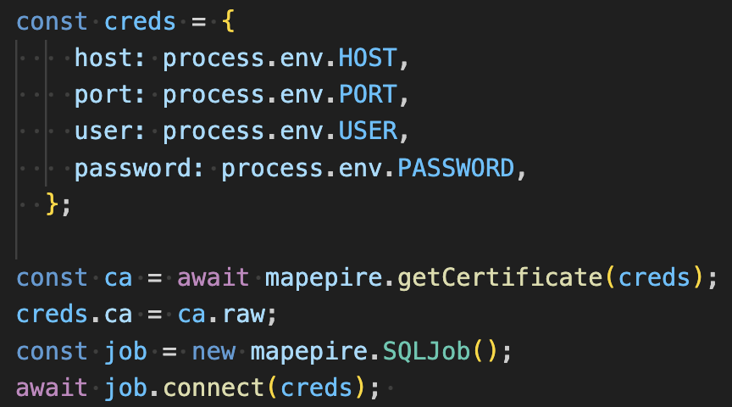
How to get started with Mapepire?
Install the mapepire client with npm install @ibm/mapepire-js
Create a .env file specifying HOST, USER, PASSWORD and PORT (this is the Mapepire server port)

Slide 27
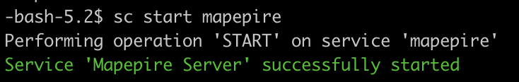
Launch the Mapepire server
Install the Mapepire server component `yum install mapepire-server
Install Service Commander `yum install service-commander`
Launch mapepire `sc start mapepire`

Slide 28

Now it’s time to write some queries!
Here is some of the functionality we have available to us
Connect to the database
Run CL commands
Run SQL commands
Run SQL commands as a batch
Run procedures
Explain a statement
Get server job
Get Mapepire version
Check liveliness
Set config
Get trace data
Close a connection

Slide 29
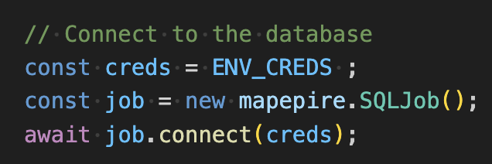
Connecting to the database
Use the connect method of the SQLJob class

Slide 30
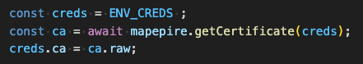
Get the server certificate
Use the getCertificate method to retrieve the TLS certificate from the db2 server. If the server is using a self signed certificate, you can add it to your connection credentials to specify you trust this certificate.

Slide 31
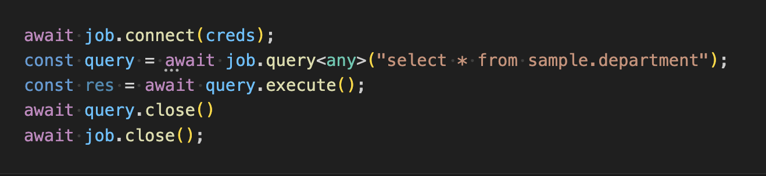
Executing a query
Use the query method of SQLJob to construct a query
Then call the queries execute method

Slide 32
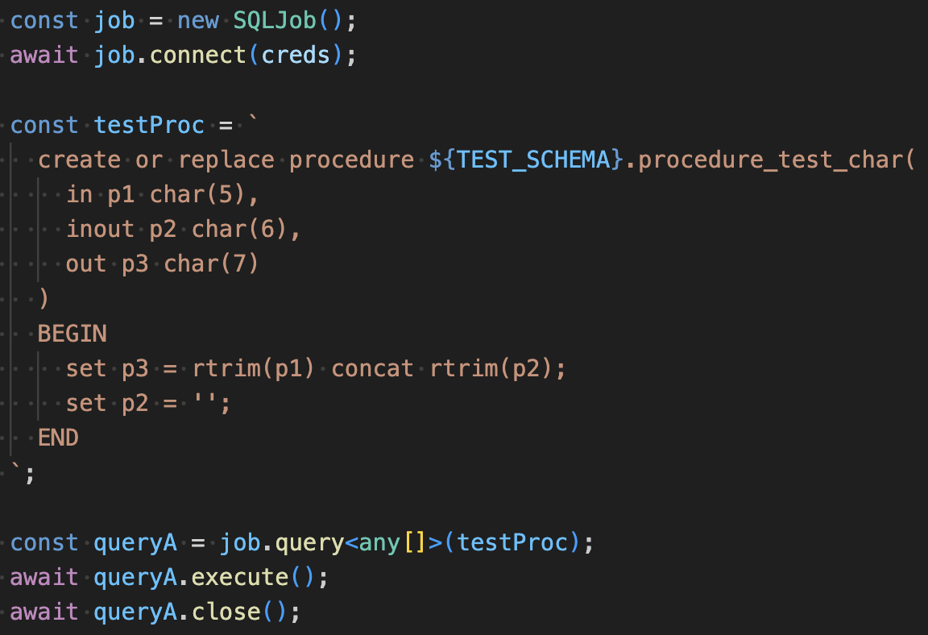
Executing a procedure
You can execute a procedure the same way that you would execute an SQL statement!

Slide 33
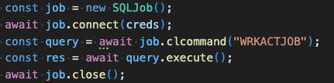
Executing a CL command
Use the CL method of the SQLJob class to execute CL commands

Slide 34
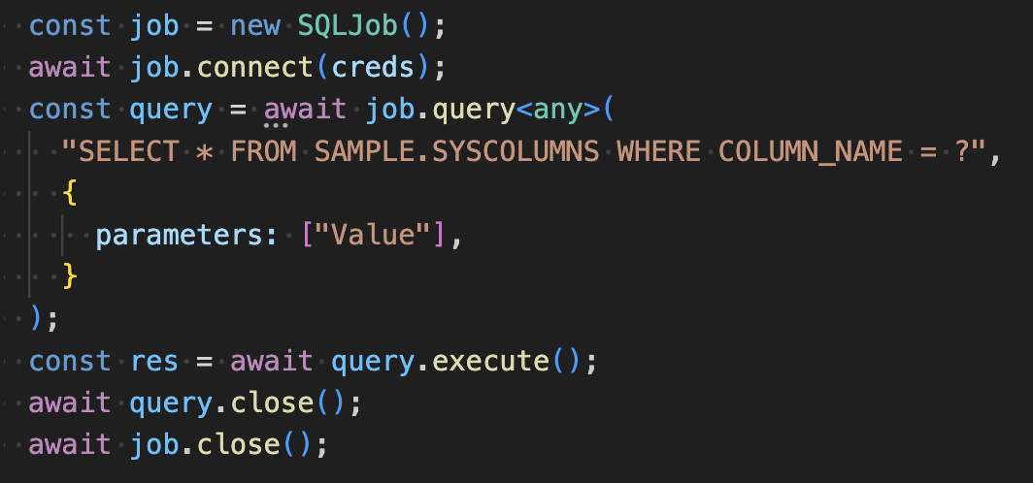
Executing a prepared statement
Use the query method of SQLJob to construct a query
Add the parameters for the prepared query
Then call the queries execute method

Slide 35
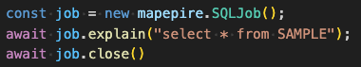
Explain an SQL statement
Use the explain method of SQLJob to explain an sql statement and return the result

Slide 36
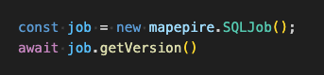
Get Mapepire server version
Use the getVersion method of SQLJob to retrieve the Mapepire server version

Slide 37
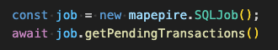
Retrieve the count of pending transactions
Use the getPendingTransactions method of SQLJob to retrieve the count of pending transactions

Slide 38
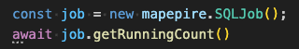
Retrieve the number of ongoing requests for a job
Use the getRunningCount method of SQLJob to retrieve the number of ongoing requests for the job

Slide 39
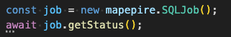
Retrieve the status for the job
Use the getStatus method of SQLJob to retrieve the status of the job
Can be any of notStarted, connecting, ready, busy, ended

Slide 40
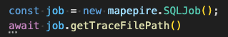
Retrieve the trace file path
Use the getTraceFilePath method of SQLJob to retrieve the file path of the trace file

Slide 41
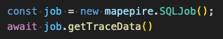
Get the server trace data
Use the getTraceData method of SQLJob to retrieve the trace data from the backend

Slide 42
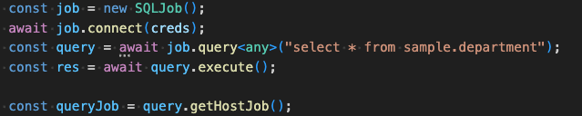
Get the SQLJob that is running the query
Use the getHostJob method of Query class to return the SQLJob that is running the query

Slide 43
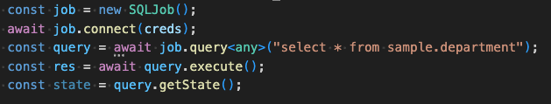
Get the state of the query
Use the getState method of Query class to return the state of the query
Can be one of "NOT_YET_RUN", "RUN_MORE_DATA_AVAILABLE", "RUN_DONE", "ERROR"

Slide 44
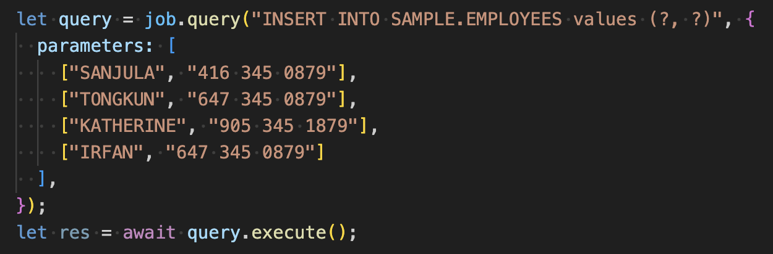
Executing a batch of statements
Use the query method of SQLJob to construct a prepared statement
Use a 2d array of parameters to ensure the query is constructed as a batch operation
Then call the queries execute method

Slide 45
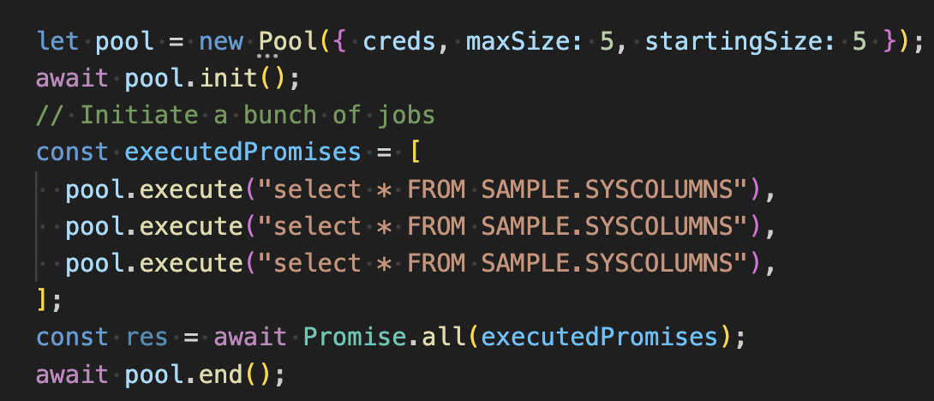
Executing statements using a pool
Initialize a new pool object
Call the pool’s execute method to run a query using any free job
Call the pool’s end method to destroy the pool and cleanup resources

Slide 46
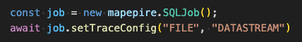
Set the backend log level
Use the setTraceConfig method of the SQLJob class to set the trace level and destination for the Mapepire server
In this case we are sending the trace data to a file, and we are using the most verbose level of logging

Slide 47
Consistent SDK behavior access languages
Guided by a unified reference architecture
https://mapepire-ibmi.github.io/reference/maintenance/referencearchitecture/
Similar experiences
Class names
Method names
Throwable types
Input parameters
Configuration options

Slide 48
Node.js vs Java Implementation
Node.js
Java
// Initialize credentials
const creds: DaemonServer = { host: "HOST", port: 8076, user: "USER", password: "PASSWORD", rejectUnauthorized: true, ca: "CA" }
// Establish connection
const job = new SQLJob();
await job.connect(creds);
// Initialize and execute query
const query = job.query("SELECT * FROM SAMPLE.DEPARTMENT");
const result = await query.execute(3);
// Convert to JSON string and output
console.log(JSON.stringify(result));
// Initialize credentials
DaemonServer creds = new DaemonServer("HOST", 8085, "USER", "PASSWORD", true, "CA");
// Establish connection
SqlJob job = new SqlJob();
job.connect(creds).get();
// Initialize and execute query
Query query = job.query("SELECT * FROM SAMPLE.DEPARTMENT");
QueryResult<Object> result = query.execute(3).get();
// Convert to JSON string and output
ObjectMapper mapper = new ObjectMapper();
mapper.enable(SerializationFeature.INDENT_OUTPUT);
String jsonString = mapper.writeValueAsString(result);
System.out.println(jsonString);

Slide 49
Future Enhancements!
More client SDKs: C#, PHP
Mapepire JDBC client
TLS enhancements
Logging and serviceability improvements

Slide 50
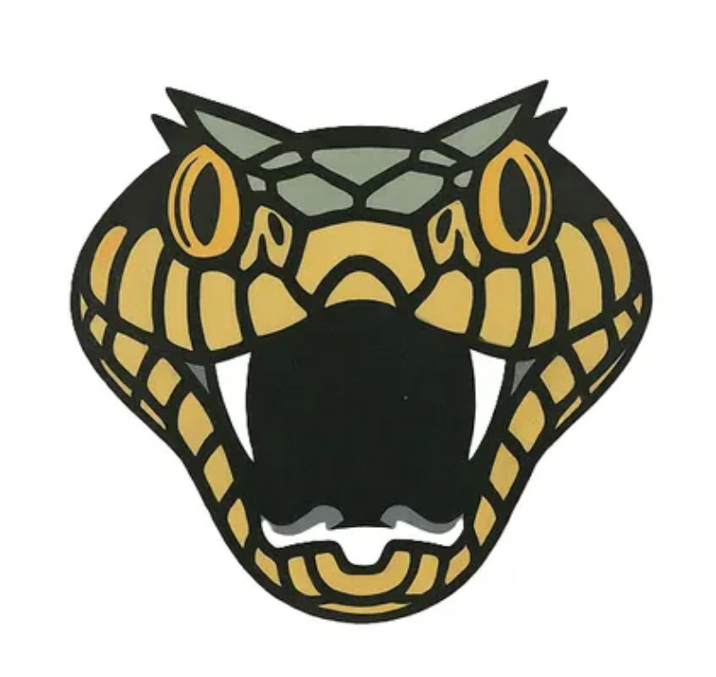
Takeaways
Config
Suitable performance
Always encrypted
Any Hardware
Any Language
Flexibility

Slide 51
Demo

Slide 52
Any Questions?

Slide 53
Important Links
Mapepire
Documentation https://mapepire-ibmi.github.io/
Server Component https://github.com/Mapepire-IBMi/mapepire-server
Node.js Client
GitHub Repository https://github.com/Mapepire-IBMi/mapepire-js
NPM https://www.npmjs.com/package/@ibm/mapepire-js
Java Client
GitHub Repository https://github.com/Mapepire-IBMi/mapepire-java
Maven Central https://central.sonatype.com/artifact/io.github.mapepire-ibmi/mapepire-sdk
Python Client
GitHub Repository https://github.com/Mapepire-IBMi/mapepire-python
PyPi https://pypi.org/project/mapepire-python/
Service Commander
GitHub Repository https://github.com/ThePrez/ServiceCommander-IBMi

Slide 54

For More Information
Links You Need | Twitter | #Hashtags
IBM i Home Page: https://www.ibm.com/it-infrastructure/power/os/ibm-i (find link to Forrester Study and updated IBM i Strategy Whitepaper) IBM Strategy Whitepaper: https://www.ibm.com/it-infrastructure/us-en/resources/power/i-strategy-roadmap/ IBM Client Success: https://www.ibm.com/it-infrastructure/us-en/resources/power/ibm-i-customer-stories/ Support Life Cycle: https://www.ibm.com/support/lifecycle/ License Topics: https://www-01.ibm.com/support/docview.wss?uid=nas8N1022087 Fortra IBM i Marketplace Survey https://www.fortra.com/resources/guides/ibm-i-marketplace-survey-results | @IBMSystems @COMMONug @IBMChampions @IBMSystemsISVs @IBMiMag @ITJungleNews @SAPonIBMi @SiDforIBMi | #PowerSystems #IBMi #IBMAIX #POWER9 #LinuxonPower #OpenPOWER #HANAonPower #ITinfrastructure #OpenSource #HybridCloud #BigData

Slide 55

Forget ODBC! Here’s a New Db2 Connector - Jonathan Zak and Sanjula Ganepola
Please take the last minute of this session to complete the evaluation. A direct link to the evaluation can be found using the QR code below.

